Slide 1


Case Study: PFEP –A Blueprint for Successful Agentic Workflows
Christopher Cowart

Slide 2


About Me
Hands-on Architect | 18+ Years Experience | Data-Driven Solutions
Core Expertise:
Intelligent Automation: Architecting auditable, closed-loop systems (BPM, HITL), and distributed systems
Process Optimization: Using statistical methods to optimize processes and incubate new capabilities (Lean, A/B Testing, Prototyping)
Clean Architecture: Building scalable solutions with modern practices (DDD/Medallion Architectures, CI/CD, IaC)
Education & Certificates:
M.S. Computer Science (In Progress, Colorado State)
Grad Cert Applied Statistics (Texas A&M)
B.S. MIS-LOM (University of Missouri)
TOGAF Certified | Pega CSSA

Slide 3
Problem – Inaction at Scale Due to Fragmentation
Problem Statement
Inventory decisions based on outdated signals and assumed ownership led to costly overstocking, critical shortages, and an inability to respond to market changes at scale.
Previous Landscape & Process
Siloed Operations: 65 sites, 65 unique systems, millions of parts.
Fragmented Purchasing: Hundreds of buyers operating independently.
Lack of Accountability: No central view or accountability.
Complete Blind Spot: Zero cross-site monitoring or insights.

Slide 4

Architecture Guardrails
Principles:
Isolate Core Systems: To protect immutable SAP fixtures, we used a replicated analytics DB as the sole data source, accepting nightly latency.
Ensure System Integrity: All write-backs were restricted to whitelisted, approved integrations to maintain data quality and security.
Leverage Supported Platforms: We chose Pega for orchestration to ensure commercial support and long-term viability.

Slide 5

Engagement Model
Principles:
Embed & Integrate: Join the team learn the culture, build trust, and contribute directly to immediate goals.
Lift & Deliver: Identify a key pain point, architect a quick, high-impact win to build credibility and demonstrate value.
Grow & Scale: Shift from doing to teaching. Help establish repeatable patterns, and scaling knowledge into existing Center of Excellence (CoE) standards

Slide 6

Target State: Data Driven Decisions, Full Accountability
Reduce Excess Inventory by 30% | $60MM
Key Capabilities Delivered:
Fresh Signals: Shifted from ad hoc to nightly.
Explicit Ownership: Assigned owners and defined SLAs for every part.
Closed Loop Control: Enabled auditable human-in-the-loop (HITL) overrides.
Centralized KPI Monitoring: Provided single pane of glass with configurable business rules.
Secure by Design: Enforced governance with RBAC and explicit work assignments.

Slide 7
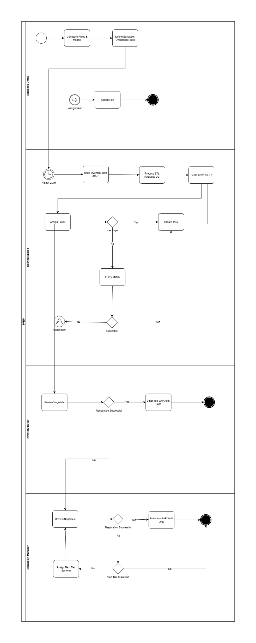
Business Process Flow
Process Overview:
Business-Owner Configuration: The Business Owner directly configures and maintains the system’s business rules and scoring models, ensuring the logic aligns with enterprise goals before the automated process begins
Automated Ingestion & Triage: The process kicks off nightly, ingesting SAP data. The Scoring Engine processes the signals, scores, each item, against the configured rules, and automatically assigns a task to the designated Inventory Buyer.
Primary Review & Action (Inventory Buyer): The buyer receives the automated task, reviews the opportunity, and negotiates. A successful outcome is logged, closing the loop for the standard process.
Automated Escalation Path: If the buyer negotiation is unsuccessful, the system automatically routes the task to an Escalation Manager for secondary, higher-level review to ensure resolution.

Slide 8
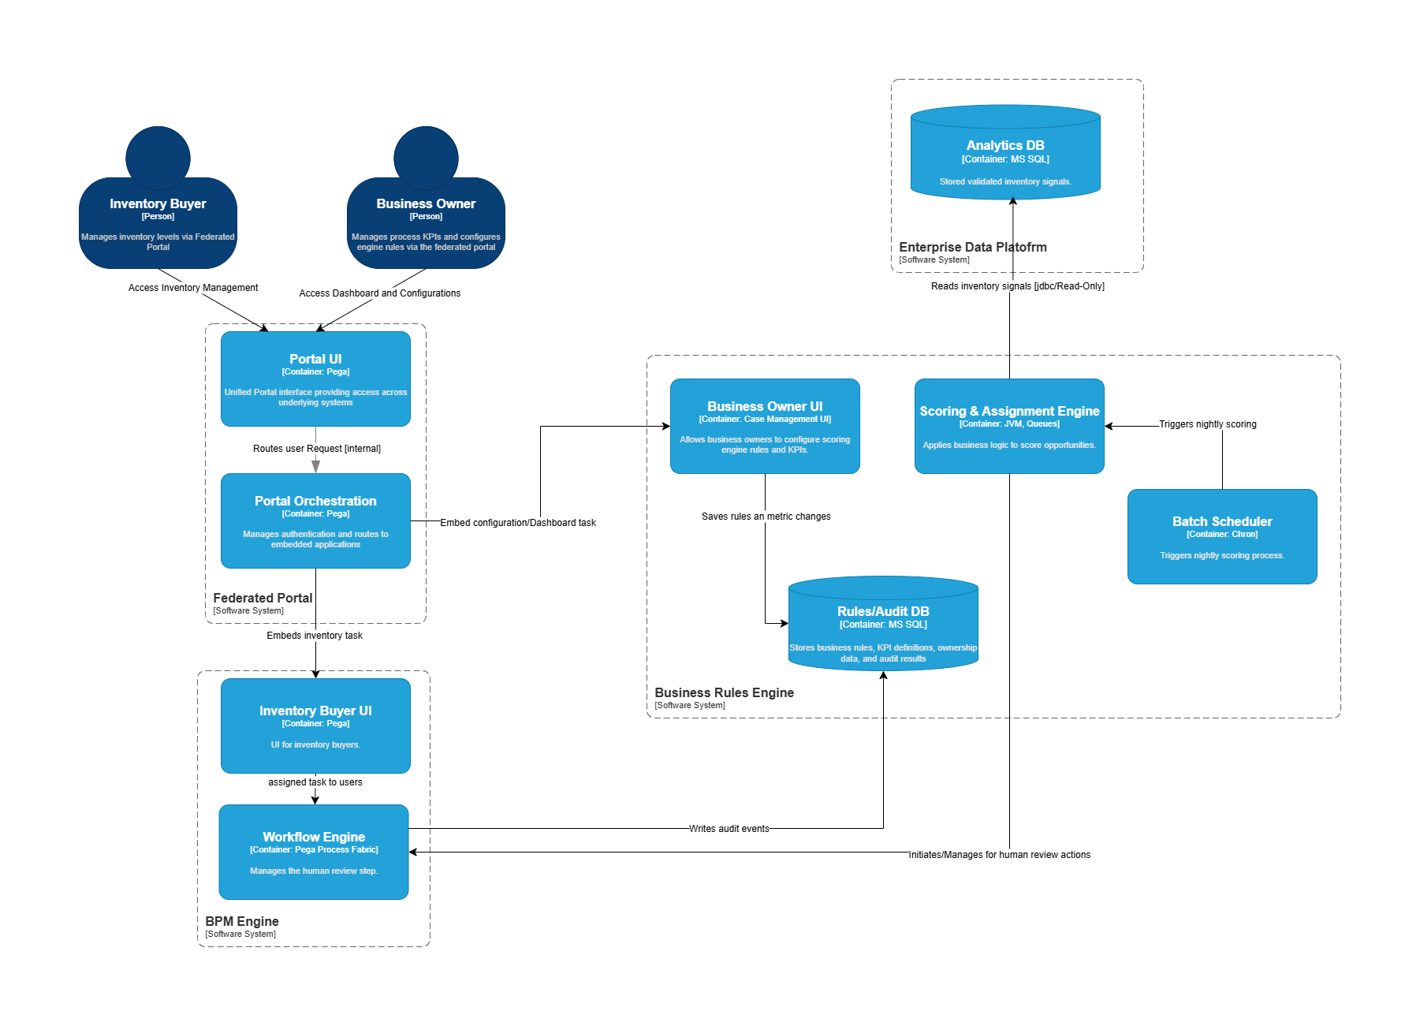
Logical Architecture
Key Components:
Personas access their respective UI through a central Federated Portal.
Core system is split between a Workflow Engine that manages human tasks and a Scoring Engine that handles automated analysis.
This system is decoupled from its data, consuming inventory signals from an Enterprise Data Platform and operational logic from a dedicated Business Rules DB.

Slide 9
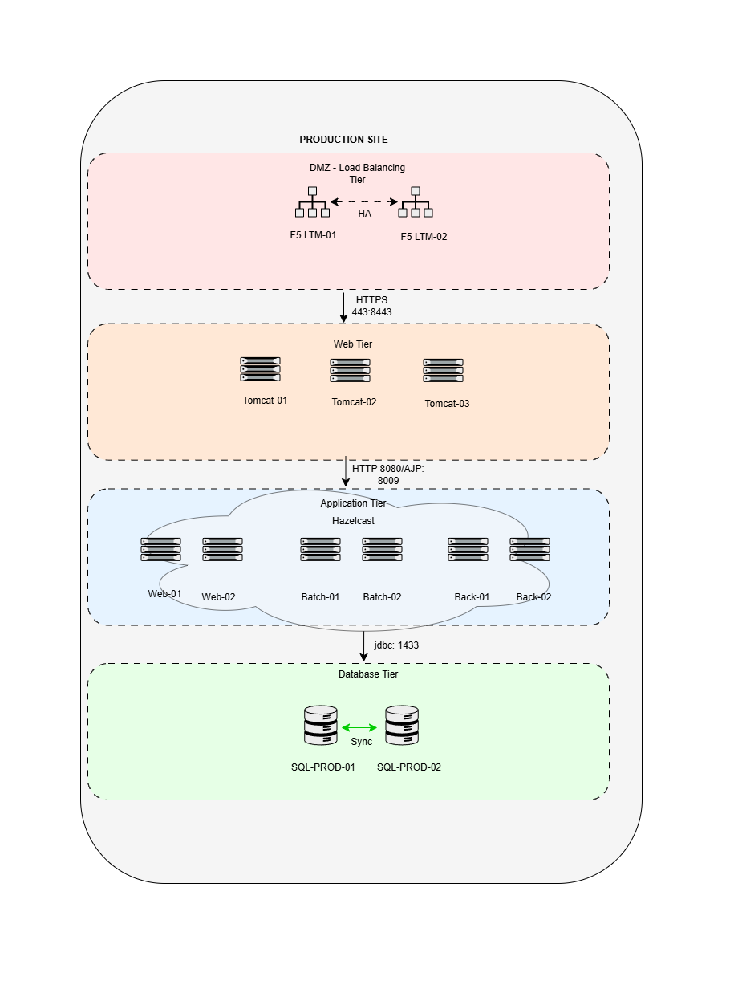
Deployment Architecture
Key Components:
Network Security: The architecture is segregated into a Public Subnet (DMZ) for ingress and a Private Subnet to protect core services.
Traffic Management: A high-availability F5 Load Balancer in the DMZ securely route all user traffic to the application tier.
Application Tier: All services run on a redundant, scalable cluster of six Tomcat servers hosted in a private subnet.
Data Tier: MS SQL Cluster segregated by workload.

Slide 10
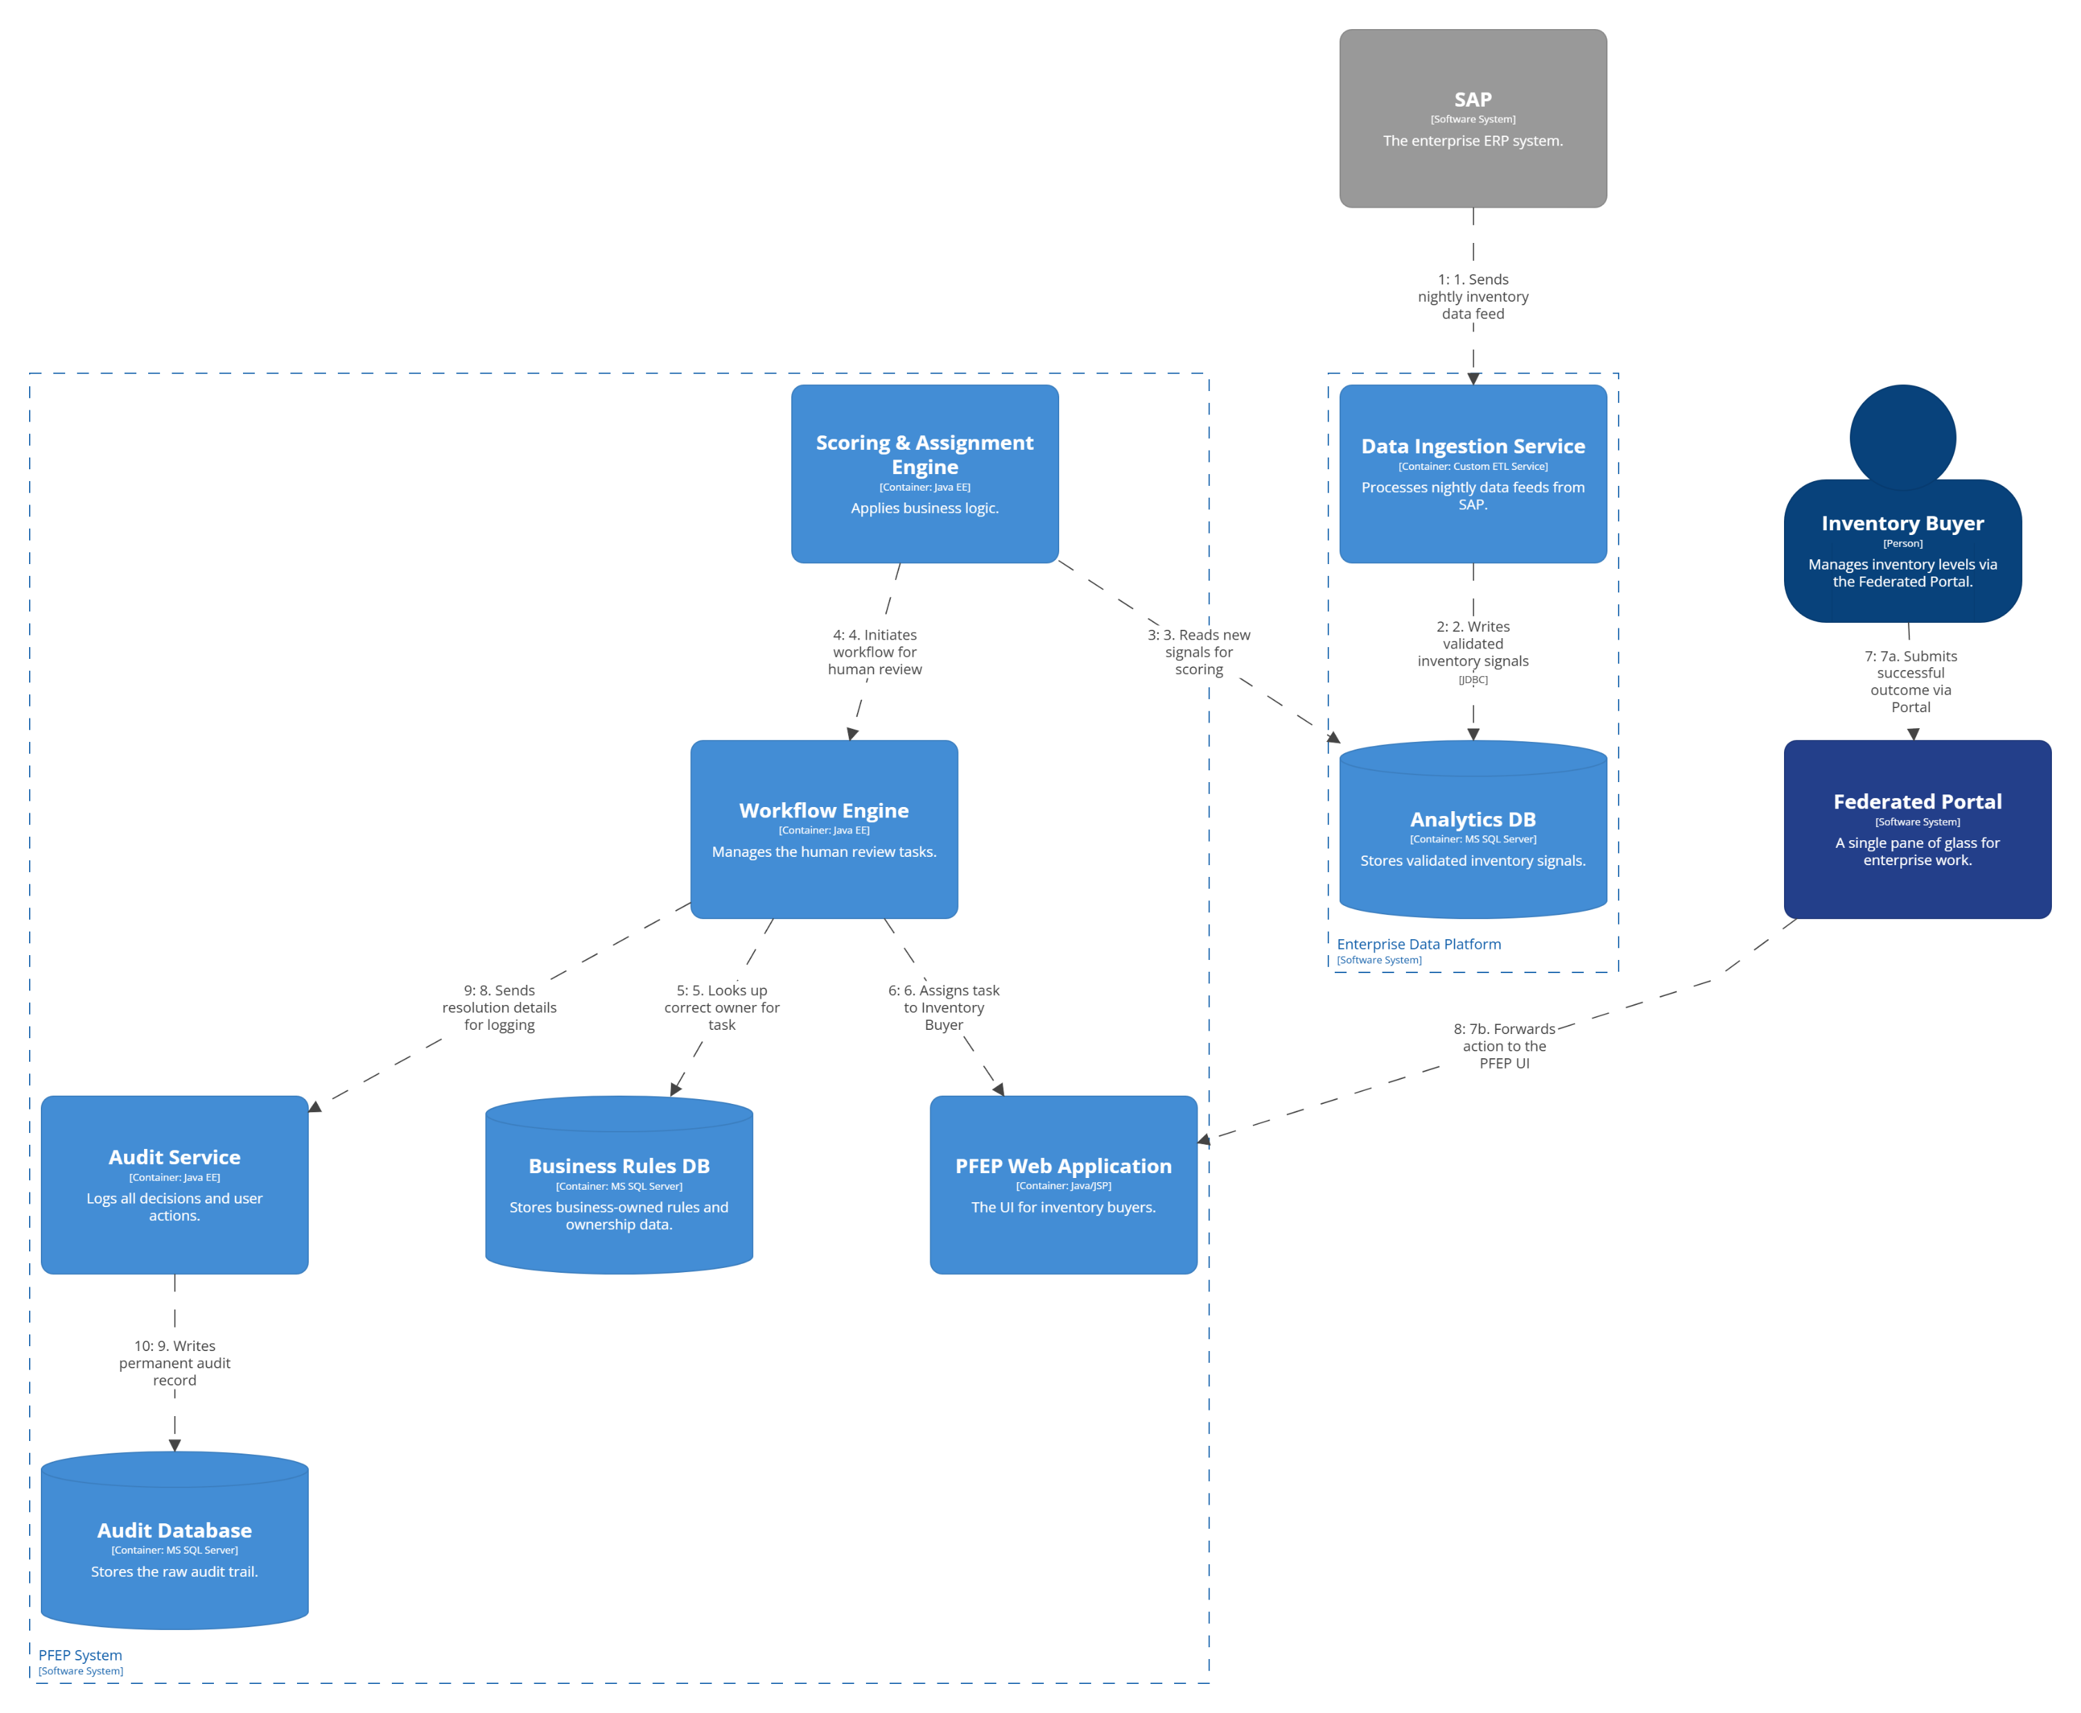
Data Flow Diagram
Key Components:
Nightly data is ingested from SAP, validated, and loaded into the Analytics DB.
The Scoring Engine uses this data configured rules to identify opportunities, then triggers the Workflow Engine to assign a task to the correct owner.
The Inventory Buyer acts on the task via the Federated Portal. The final resolution is logged in the Audit Database, completing the closed loop.

Slide 11

30% Reduction in Excess Inventory ($60MM Savings)
Operational Improvements:
Drastic Reduction in Manual Work: Automated over 80% of the initial opportunity identification and triage processes.
Increased Process Velocity: Reduced the average time-to-decision for an inventory issue from 5 days to less than 24 hours.
Full auditability: Achieved 100% traceability for all inventory decisions and overrides, simplifying compliance.
Business Enablement:
High User Adoption: Reached 95% adoption among all inventory buyers within the first six months.
Empowered Decision-Making: Provided business users with a single pane of glass, giving them visibility and tools to negotiate and resolve issues efficiently.
Enabled Continuous Improvement: The business is now able to tune and deploy new scoring rules in under an hour, without IT intervention.

Slide 12
Lesson: The Full Lifecycle of an Internal PaaS
We architected the PFEP solution by first creating a reusable, on-premise Platform as a Service (PaaS). This provided the standardized deployment pipelines and observability, allowing the PFEP team to focus purely on business logic.
The Challenge (Victim of Success): The platform was so successful that multiple new business units wanted to onboard onto the specialized solution. Our biggest challenge became securing buy-in and a funding model to scale the shared infrastructure we had created.
The Learning: Building a successful internal PaaS requires two key parts; a solid technical foundation, and an enterprise-level strategy for funding and governance to support its growth.

Slide 13
Summary & Key Takeaways
The Problem: Fragmented data across 65 on-premise sites led to an inability to act at scale, resulting in millions of dollars in excess inventory, with no scalable process for resolution.
The Solution: To solve this, I first architected and built a reusable internal PaaS. On that platform, we deployed a closed-loop decisioning system that centralized the workflow and empowered business owners.
The Outcome: The project was a landmark success, delivering a $60MM reduction in excess inventory. It also provided a powerful lesson on the need for a proactive funding model to scale successful internal platforms, creating a reusable pattern for future agentic workflows.
My Role: As the lead solution architect, my role was end-to-end. I designed and developed the PFEP application’s architecture but also the underlying internal PaaS it runs on, creating a scalable enterprise-level solution from the hardware up.

Slide 14

Applying the PFEP Patterns to Agentic Workflows
The PFEP architecture is a proven, reusable model for creating high-value agentic workflows. By replacing data context, this pattern can be applied to other domains
Sensors: Ingest application data from SAP.
Brain: The Scoring Engine applied business rules to identify opportunities.
Actuators: The Workflow Engine created tasks for buyers to task action.
Learning Loop: Business Owners used dashboards and UIs to tune the rules based on outcomes.

Slide 15

Q&A/Thank You

